Slide 1

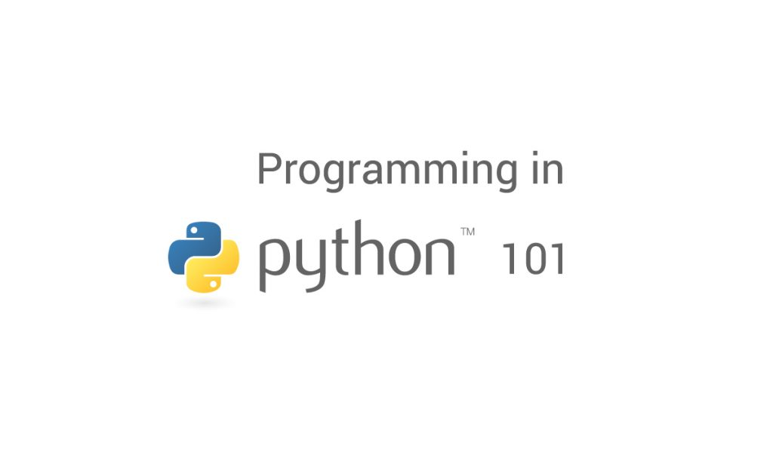

PAUSİBER 2024-2025 Python 101 Kursu

Slide 2

Python Nedir ?
Python, 1980'lerin sonlarında Guido van Rossum tarafından tasarlanan, üst düzey, genel amaçlı bir programlama dilidir.
Interpreted: no compiling, interactive
High-level: garbage-collected (auto. memory management),
dynamically typed (with possibility of statical typing)
General-purpose: multi-paradigm (object-oriented, functional, reflective, imperative),
extremely versatile (scripting, application, server etc.)

Slide 3
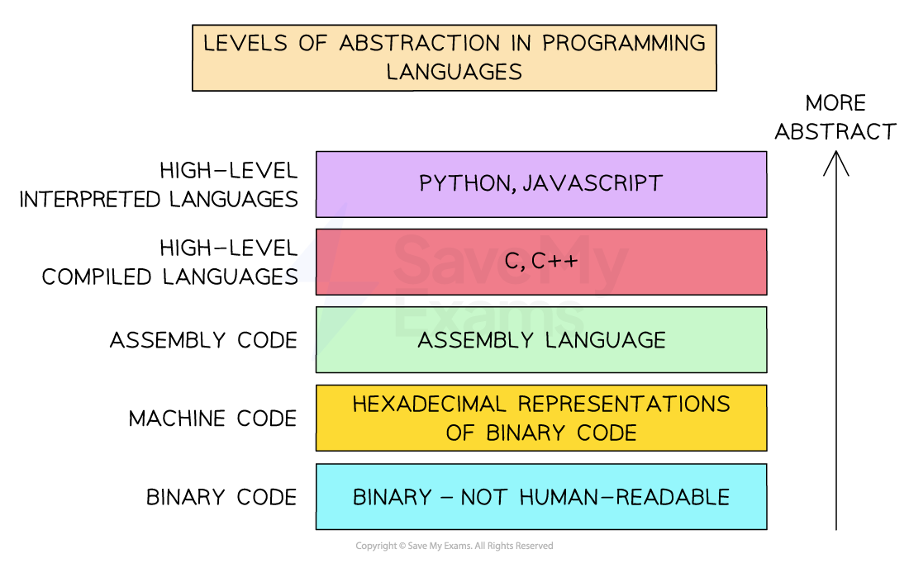

Slide 4
Neden Python ?
The language is easy to use, powerful, versatile, and productive
Very approachable (also for non-developers)
Speed of coding (approx. x5 faster than typical low-level language)
Free to use (open source) - High pace of development
Huge, healthy, active and supportive community (easy to find help)
Batteries included (many built-in features and countless 3rd-party libraries)
Highly compatible (great interface tool)

Slide 5
Sounds like a good idea?

Slide 6
What about the pros?
Instagram – All Python!
Reddit – All Python!
Dropbox – Desktop client is written entirely in Python (400 million users)
Google
Had to buy YouTube because of too fast feature implementation
”Python where we can, C++ where we must”
Facebook, Netflix, Spotify, NASA, CERN, Yahoo!, Wikipedia …
Corporate support (many libraries fully maintained by developers at Google, Facebook etc.)
Scalable and maintainable

Slide 7
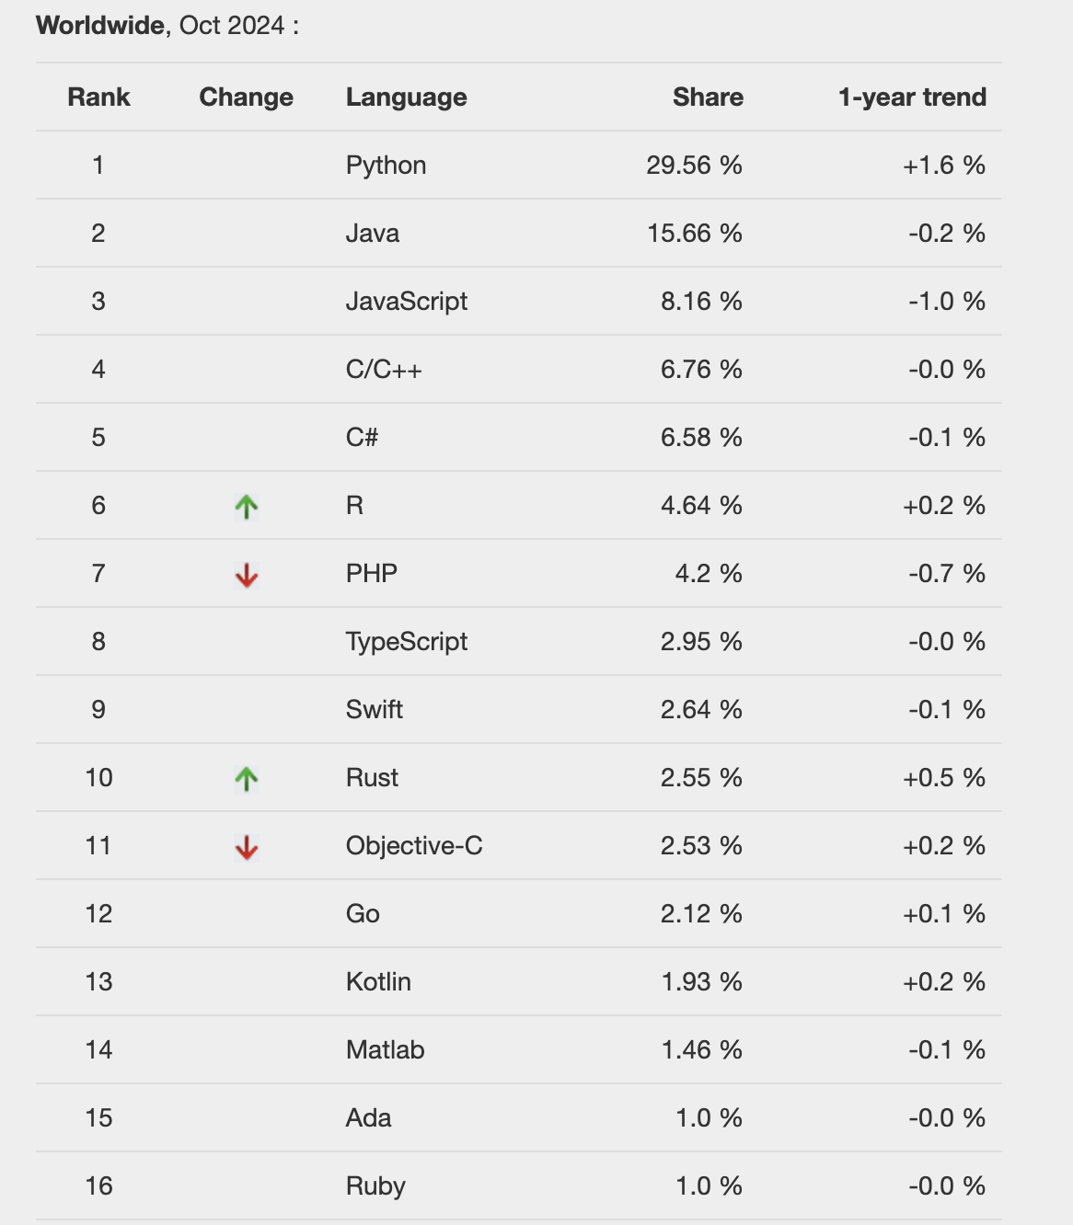
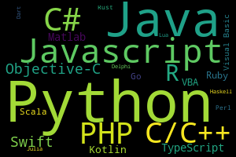
Python’s popularity
PYPL (PopularitY of Programming Language) based on Google searches
Most popular language
Fastest-growing language

Slide 8
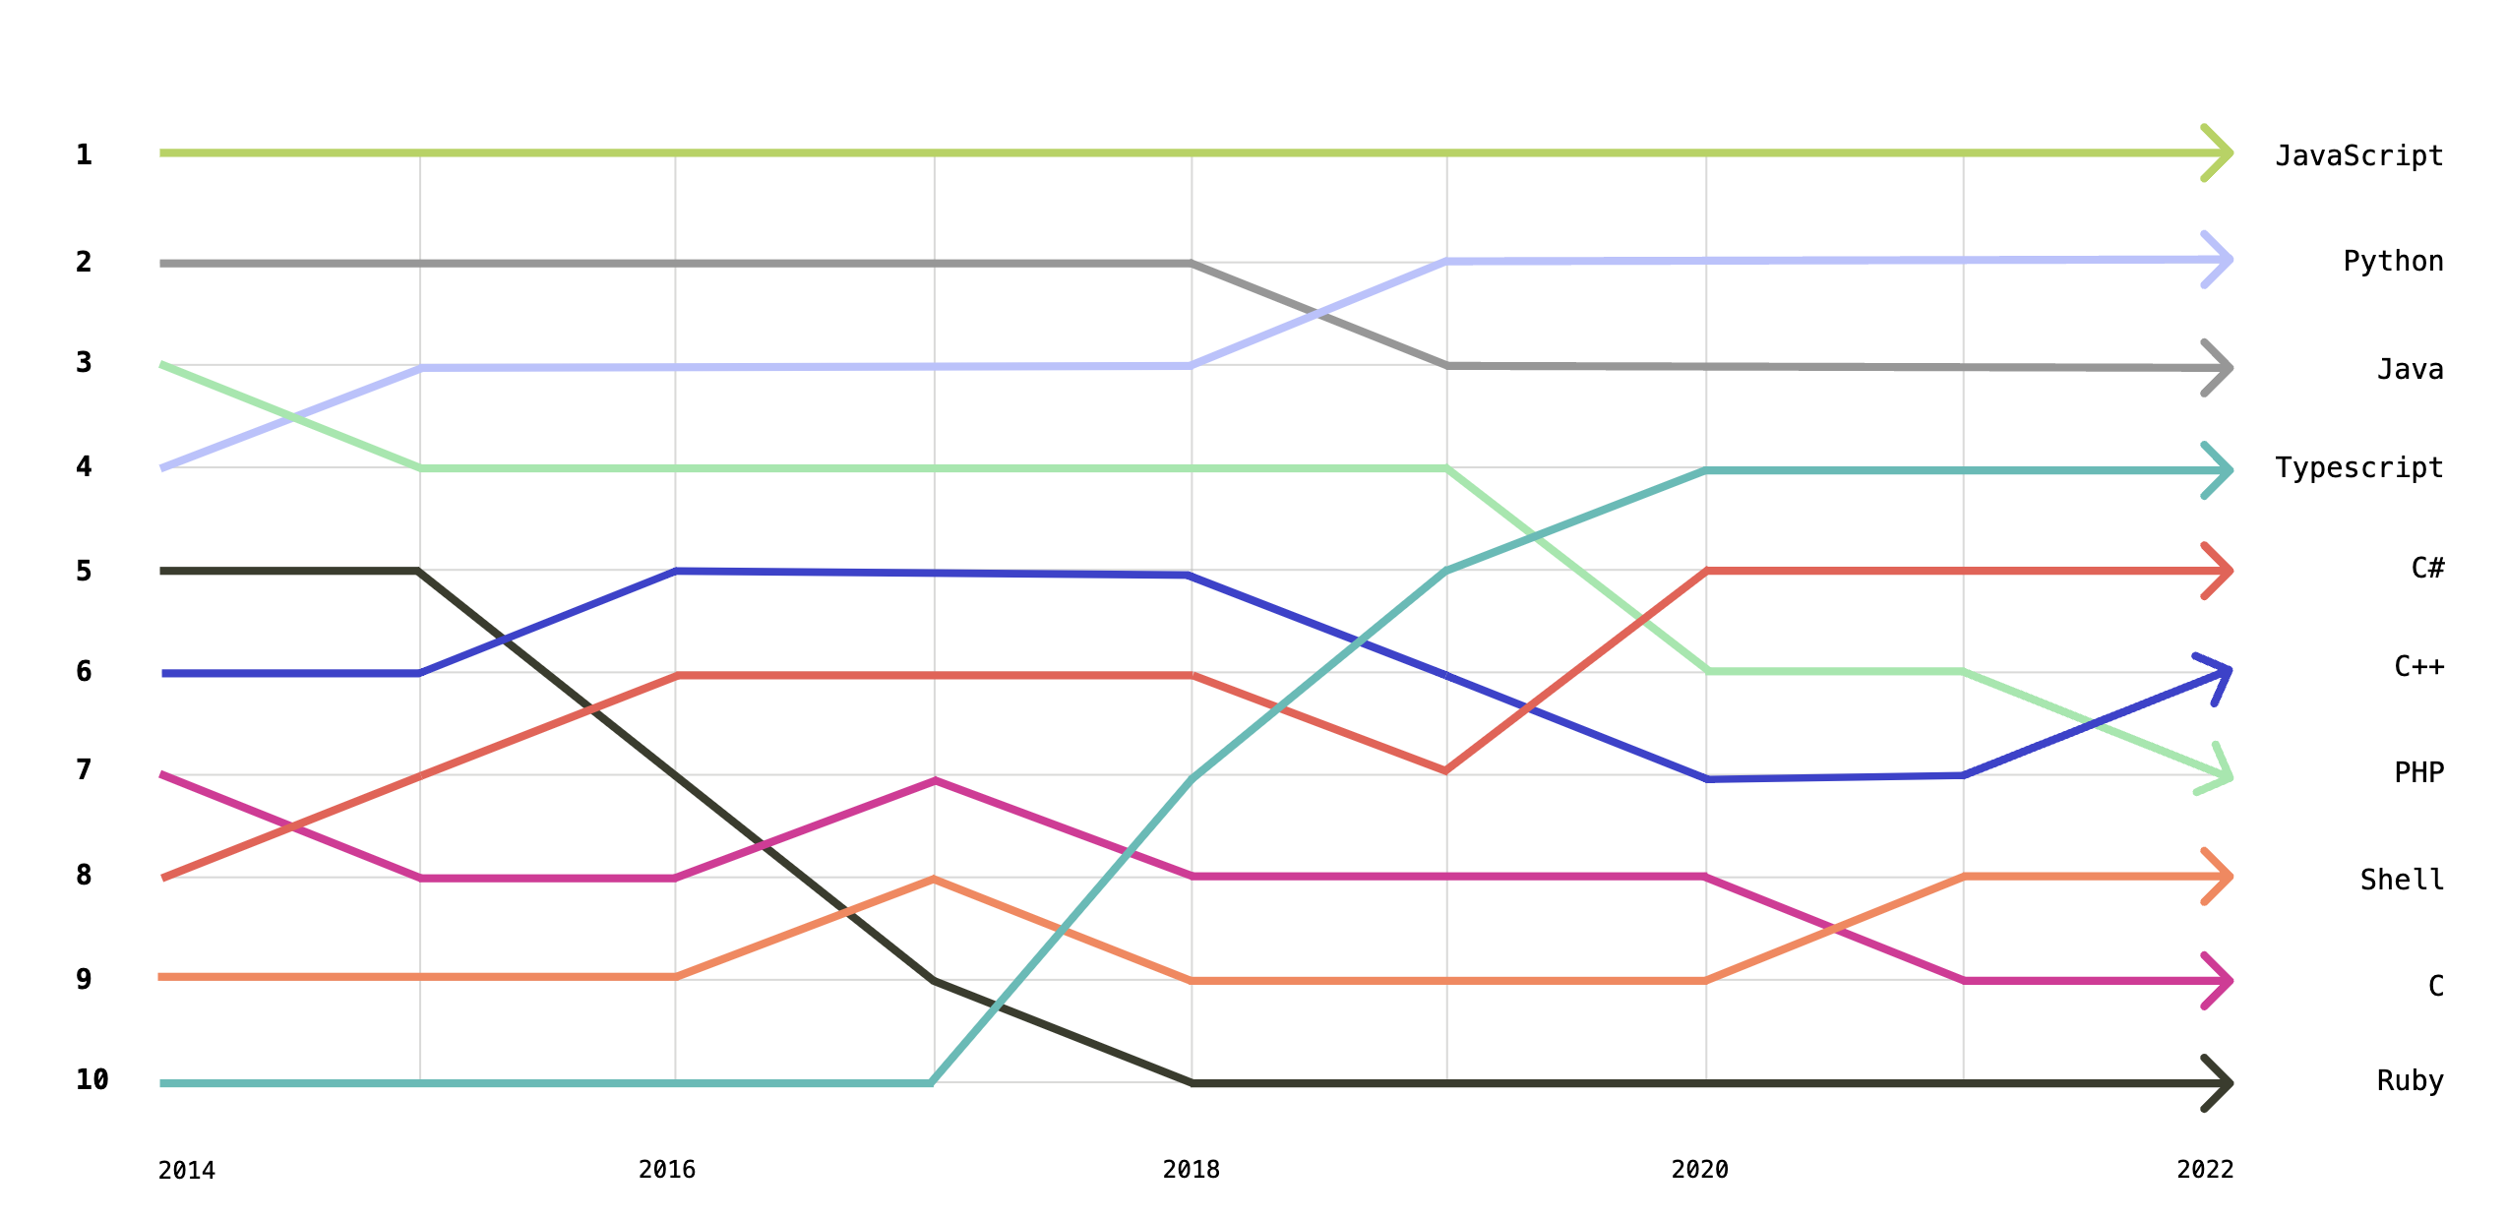
Python’s popularity
GitHub’s largest languages (the world’s largest repository host)
Highly popular language
Fast growing language

Slide 9
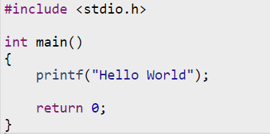

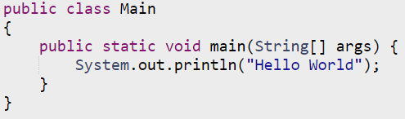
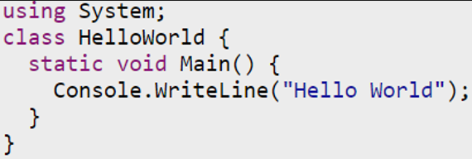
Hello World in six languages
C/C++
Fortran
Java
MATLAB
Python
C# (pronounced C-sharp)
Low level / High level languages
Simple explanation of why Python is so popular.

Slide 10
What can you do with Python?
Automate the boring stuff
Scripts for repetitive/manual tasks
Software development
Desktop GUI applications
Web development
Websites and web applications
Dashboards
Data Science
Data management/handling/processing/analysis
Data visualization
Machine Learning, Deep Learning/AI etc.
Web scraping
IOT, Smart House control, embedded applications and much much more

Slide 11
Exercise
Enough talking - Now it’s time for some hands-on experience
Execute your first Python script
and make that hello statement happen!
There are a couple more exercises in the course material under Session 0.

